Slide 1
Final Project Presentation Sparse CNN Hardware Design
Digital Signal Processing in VLSI Design
GROUP 12
R09921132 劉彥甫
R09921129 黃意堯

Slide 2
Motivation and Prior Works
Two additional benefit of sparse matrix convolution are saving computing power and saving memory usage. Like we talked about FFT Radix-n design, does sparse convolution really save cost in hardware perspective?
The irregular sparse patterns introduced by both weights and activations are much more challenging for efficient computation. For example, due to the issues of access contention, workload imbalance, and tile fragmentation, the state-of-the-art sparse accelerator SCNN fails to fully leverage the benefits of sparsity, leading to nonoptimal results for both speedup and energy efficiency.

Slide 3
System Architecture and Design Features
Use streaming data flow to reduce memory traffic/usage.
Use one adder working at 16 times clock frequency to solve memory access contention which mentioned at prior works.
Use parallel adder to solve the problem on power consuming of one adder.
Use clock gated to save some power.

Slide 4
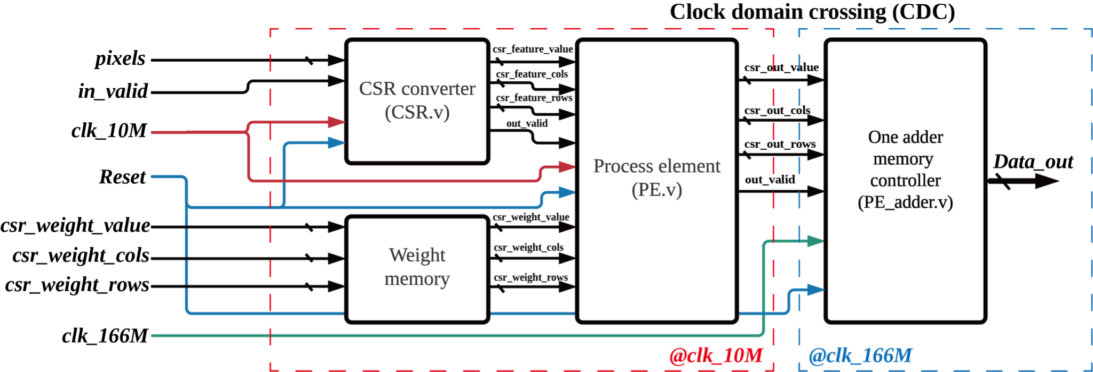
System Architecture and Design Features (cont.)
Sparse Convolution

Slide 5
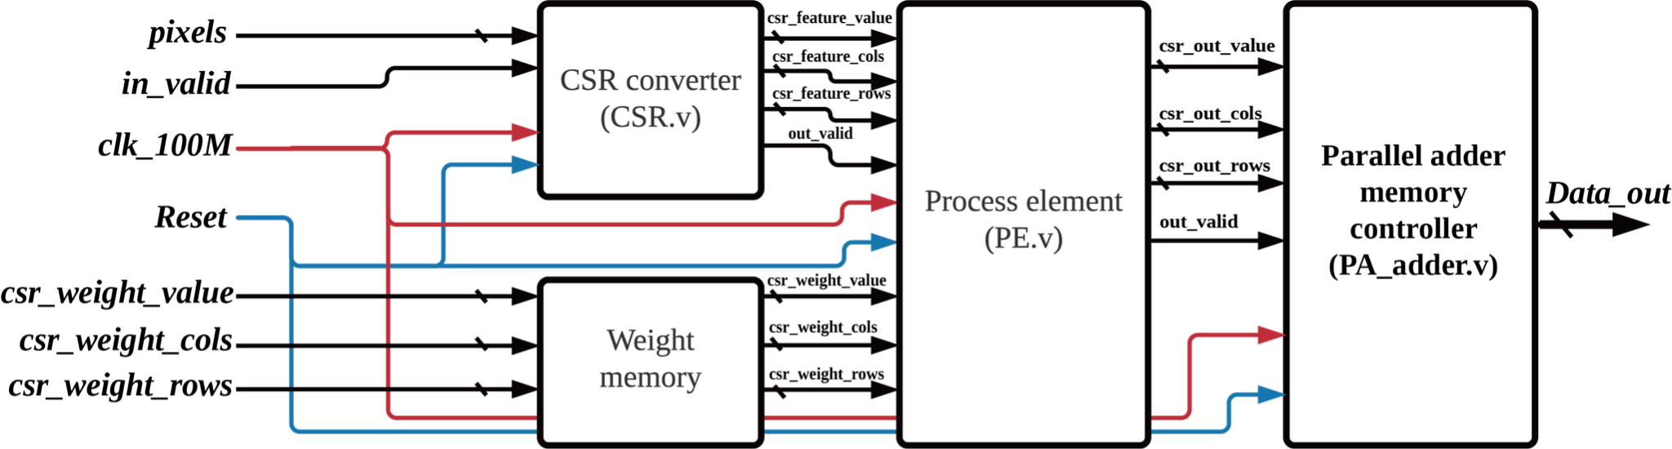
System Architecture and Design Features (cont.)
Sparse Convolution with parallel adder

Slide 6
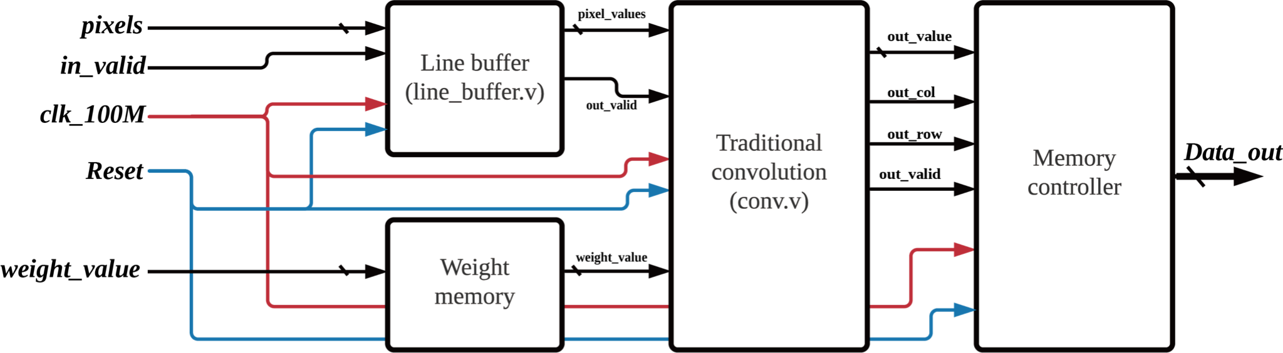
System Architecture and Design Features (cont.)
Traditional Convolution

Slide 7
Design Space Exploration (and Methodology)
CSR module: data-stream v.s data-batch (in report)
CSR/adder module: reference design v.s 2x parallel design (in report)
PE module: reference design v.s 2x parallel v.s 2x pipeline (in report)
Write back module: one adder in 16x fclk v.s fully parallel (in report)
Traditional convolution v.s Sparse convolution @ different sparsity

Slide 8
Implementation Results
Sparse convolution@10/166.67MHz (PE_CSR_clk/Memory_clk)
 | Area[um^2] | Power[W](prime_time) | Power*Area | Latency [ns] (Time to finish one frame)
Input@0%sparsity | 2,417,592 um^2 | 0.154 W | 372,309 | 203,955 ns

Slide 9
Implementation Results
Sparse convolution with parallel adder@100MHz
 | Area[um^2] | Power[W](prime_time) | Power*Area | Latency [ns] (Time to finish one frame)
Input@0%sparsity | 21,267,287 um^2 | 0.482 W | 10,250,832 | 21,265.3 ns

Slide 10
Implementation Results
Traditional convolution@100MHz
Traditional | Area[um^2] | Power[W](prime_time) | Power*Area | Latency [ns] (Time to finish one frame)
Input@0%sparsity | 1,569,046 um^2 | 0.1572 W | 246,654 | 12,996.6ns

Slide 11
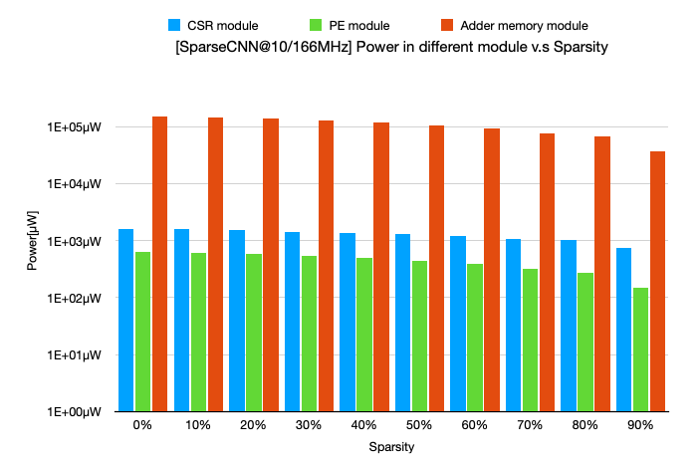
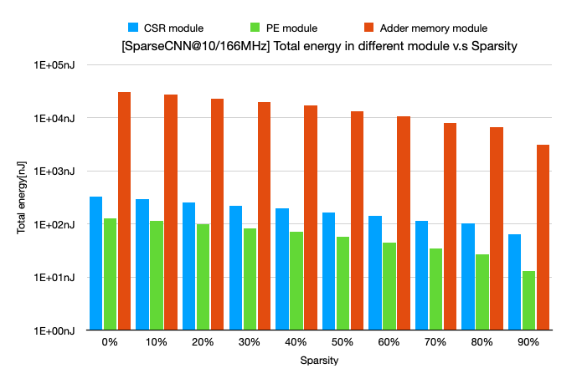
Performance Comparison
Difference between sub-modules in SparseCNN

Slide 12
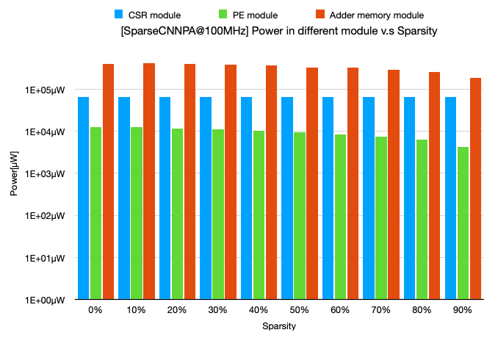
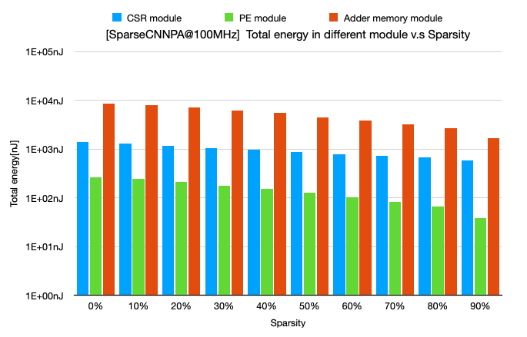
Performance Comparison
Difference between sub-modules in SparseCNNPA

Slide 13
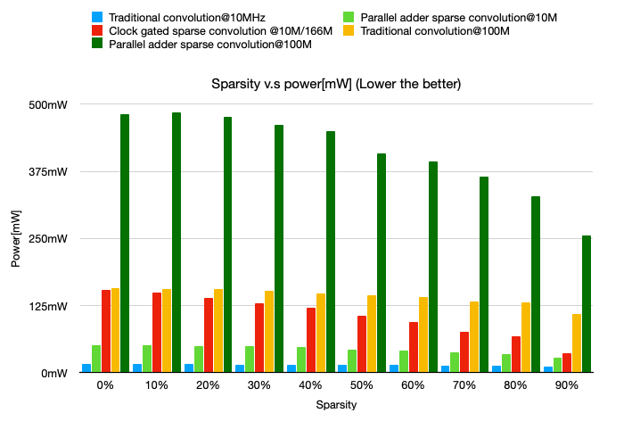
Performance Comparison
Traditional convolution v.s Sparse convolution

Slide 14
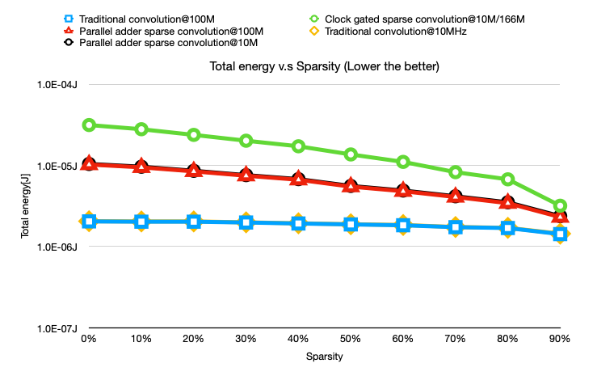
Performance Comparison
Traditional convolution v.s Sparse convolution

Slide 15

Performance Comparison
Traditional convolution v.s Sparse convolution@0% sparsity
 | Area[um^2] | Power[W](prime_time) | Power*Area | Latency [ns] (Time to finish one frame) | Total Energy [J]
Taditional convolution@0% sparsity | 1,569,046 um^2 | 0.1572 W | 244,614 | 12,996.6ns | 2.04E-6
Sparse CNN@0%sparsity | 2,417,592 um^2 | 0.154 W | 372,309 | 203,955 ns | 3.14E-5
Sparse CNN parallel adder@0%sparsity | 21,267,287 um^2 | 0.482 W | 10,250,832 | 21,265.3 ns | 1.02E-5

Slide 16
Performance Comparison
Traditional convolution v.s Sparse convolution@90% sparsity
 | Area[um^2] | Power[W](prime_time) | Power*Area | Latency [ns] (Time to finish one frame) | Total Energy [J]
Taditional convolution@90% sparsity | 1,569,046 um^2 | 0.110 W | 171,967 | 12,996.6ns | 1.43E-06 J
Sparse CNN@90%sparsity | 2,417,592 um^2 | 0.0369 W | 89,209 | 86355.3 ns | 3.19E-06 J
Sparse CNN parallel adder@90%sparsity | 21,267,287 um^2 | 0.256 W | 5,444,425 | 9015.3 ns | 2.31E-06 J

Slide 17
Summary and Conclusions
In algorithm perspective, sparse convolution should save computing effort which is also true in hardware design. In hardware perspective, sparse convolution need more memory access than traditional convolution which results in large area and power/time consuming memory blocks.
Sparse CNN needs extra memory to save CSR data and needs to deal with output memory access contention problem.

Slide 18
References
[1] F. Li, G. Li, Z. Mo, X. He and J. Cheng, "FSA: A Fine-Grained Systolic Accelerator for Sparse CNNs," in IEEE Transactions on Computer-Aided Design of Integrated Circuits and Systems, vol. 39, no. 11, pp. 3589-3600, Nov. 2020, doi: 10.1109/TCAD.2020.3012212.

